Slide 1

EECS 370 - Lecture 3
LC2K
Live Poll + Q&A: slido.com #eecs370
Poll and Q&A Link

Slide 2
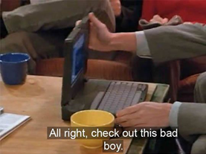
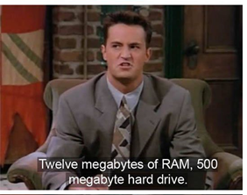
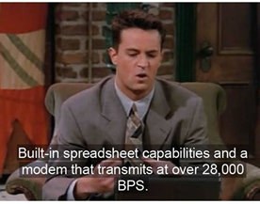

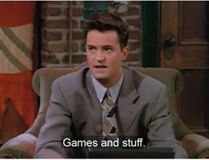

Slide 3
Important Data

Slide 4

Lingering Questions
"How does the compiler know what is what? For example how does the computer know that 100011 is supposed to be a char 'C' instead of an unsigned int of 67, or a signed int of -61."
The compiler knows because the user will label a variable as "char" or "int" or "unsigned int"
The hardware doesn't know or care: it's just 100011 and trusts that the program will execute the appropriate instructions
Lingering questions / feedback? I'll include an anonymous form at the end of every lecture: https://bit.ly/3oXr4Ah

Slide 5
Announcements
HW 1
Posted on website, due next Friday
P1
3 parts, first part due in two weeks
Setup clinic
Need help getting your debugger setup?
Dedicated help on Friday!
Homework 1 has a question requiring you to show debugger is setup
OH
Going on now: see website->Google Calendar->Office Hours

Slide 6
Instruction Set Architecture (ISA) Design Lectures
“People who are really serious about software should make their own hardware.” — Alan Kay
Lecture 2: ISA - storage types, binary and addressing modes
Lecture 3 : LC2K
Lecture 4 : ARM
Lecture 5 : Converting C to assembly – basic blocks
Lecture 6 : Converting C to assembly – functions
Lecture 7 : Translation software; libraries, memory layout
Notes:
Known for
Dynabook object-oriented programming Smalltalk

Slide 7
Reminder- System Organization
Let's execute this short program:
ADD X0, X1, X2
SUB X1, X2, X0
CPU
Memory
Address FFFF…
Address 0000
Registers
ALU
Load
X0 | 0
X1 | 7
X2 | -3
+
ADD X0, X1, X2
Address 0102
Store
32 x 64 bits
Program counter
0102
Gigabytes to Terabytes
0102

Slide 8
Reminder- System Organization
Let's execute this short program:
ADD X0, X1, X2
SUB X1, X2, X0
CPU
Memory
Address FFFF…
Address 0000
Registers
ALU
Load
X0 | 4
X1 | 7
X2 | -3
+
SUB X1, X2, X0
Address 0103
Store
32 x 64 bits
Program counter
0103
Gigabytes to Terabytes
0103

Slide 9
Reminder- System Organization
Let's execute this short program:
ADD X0, X1, X2
SUB X1, X2, X0
CPU
Memory
Address FFFF…
Address 0000
Registers
ALU
Load
X0 | 4
X1 | -7
X2 | -3
+
Store
32 x 64 bits
Program counter
0104
Gigabytes to Terabytes

Slide 10
Encoding Instructions
We saw last time that binary numbers can represent signed and unsigned numbers, chars, and fractional numbers
But they must also represent instructions themselves!
After all, memory is just a collection of 1s and 0s
We need a way of encoding instructions in order to store them in memory

Slide 11
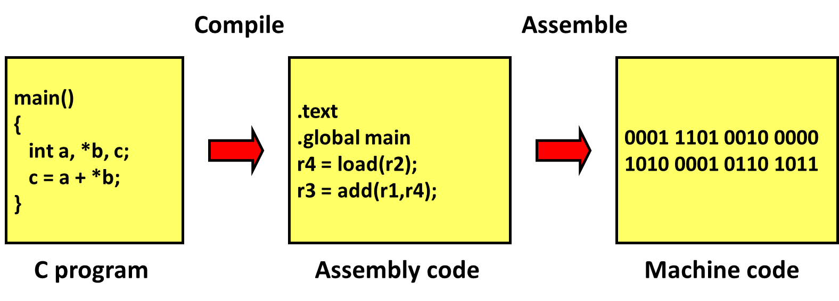
Software program to machine code
Example ISA
(simplified)

Slide 12
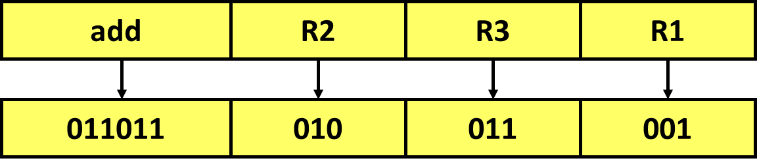
Assembly Instruction Encoding
Since the EDSAC (1949) almost all computers stored program instructions the same way they store data.
Each instruction is encoded as a number
This is the number stored in memory!
Example ISA
(simplified)
011011010011001 = 2⁰ + 2³ + 2⁴ + 2⁷ + 2⁹ + 2¹⁰ + 2¹² + 2¹³
= 13977
Poll: How many different "operation codes" could be supported by this ISA? How many registers?
Live Poll + Q&A: slido.com #eecs370

Slide 13

What if we run out of registers?
Modern architectures give us between 4 and 64 registers
What if I want to sort a list of 1000 integers?
Need to make use of memory
Large array of storage accessed using memory addresses
A machine with a 32 bit address can reference memory locations 0 to 2³²-1 (or 4,294,967,295).
A machine with a 64 bit address can reference memory locations 0 to 2⁶⁴-1
(or 18,446,744,073,709,551,615—18 exa-locations)
load instructions ready from memory, places in a register
store instructions write from register into memory
"We will never make a 32-bit operating system" - Bill Gates, 1983

Slide 14
Memory architecture: The ARM (Linux) Memory Image
Stack
Heap data
Stack frames: local variables, parameters, etc.
Dynamically allocated data—new or malloc()
Static data
Global data and static local data
Text
Machine code instructions (and some constants)
Reserved
Reserved for operating system
0

Slide 15
Addressing Modes
Direct addressing
Register indirect
Base + displacement
PC-relative

Slide 16
Direct Addressing
Example ISA
(simplified)
Consider this code:
const double PI = 3.14;
double two_pi() {
return 2*PI;
}
When we load PI, it's ALWAYS the same address
If the ISA supports it, we can just hardcode that address in the instruction
Like register addressing
Specify address as immediate constant
load r1, mem[1500] ; r1 ← contents of location 1500
jump mem[3000] ; jump to address 3000
Useful for addressing locations that don’t change during execution
Branch target addresses
Global/static variable locations
Not practical in modern ISAs… if we have 32 bit instructions and 32 bit addresses, the entire instruction is the address!

Slide 17
Register indirect
Example ISA
(simplified)
Consider this code:
int my_arr[2] = {6666, 7777};
int* ptr = &my_arr[0];
for(int i=0; i<2; i++) {
int x = *ptr;
ptr++;
}
Everytime we load into x, it's a different address
But the address is always stored in another variable
If ISA supports it, we could use a load like this
load r1, mem[r2]

Slide 18
Register indirect
Example ISA
(simplified)
Consider this code:
int my_arr[2] = {6666, 7777};
int* ptr = &my_arr[0];
for(int i=0; i<2; i++) {
int x = *ptr;
ptr++;
}
load r1, mem[ r2 ]
add r2, r2, #4
load r1, mem[ r2 ]
register file
memory
R1
6666
R2
3340
6666
3340
7777
3344

Slide 19
Register indirect
Example ISA
(simplified)
Consider this code:
int my_arr[2] = {6666, 7777};
int* ptr = &my_arr[0];
for(int i=0; i<2; i++) {
int x = *ptr;
ptr++;
}
load r1, mem[ r2 ]
add r2, r2, #4
load r1, mem[ r2 ]
register file
memory
R1
6666
R2
3344
6666
3340
7777
3344

Slide 20
Register indirect
Example ISA
(simplified)
Consider this code:
int my_arr[2] = {6666, 7777};
int* ptr = &my_arr[0];
for(int i=0; i<2; i++) {
int x = *ptr;
ptr++;
}
load r1, mem[ r2 ]
add r2, r2, #4
load r1, mem[ r2 ]
register file
memory
R1
6666
R2
3344
6666
3340
7777
3344
This is better, but we can be more general

Slide 21
Base + Displacement
register file
memory
2340
Consider this code:
struct My_Struct {
int tot;
//...
int val;
};
My_Struct a;
//...
a.tot += a.val;
If a register holds the starting address of "a"…
Then the specific values needed are a slight offset
Base + Displacement
reg value + immed
R2
5555
2340
6666
2372
load r1, mem[r2 + 32]
Very general, most common addressing mode today

Slide 22
Class Problem
a. What are the contents of register/memory after executing the following instructions
r2 = load mem[r3]
r3 = load mem[r2+4]
store mem[r2+8], r3
register file
memory
R1
0
108
100
R2
10
-1
104
R3
108
100
108
Poll: What are the contents of register / memory?
Notes:
load Rx M[M[y] becomes
load Rt M[R0+ y]
load Rx M[Rt +0]

Slide 23
PC-relative addressing
Relevant for P1.a!
Variant on base + displacement
Remember PC is "Program Counter", keeps track of which line (memory address) of the program we're at
PC register is base, longer displacement possible since PC is assumed implicitly (more bits available)
Used for branch instructions
jump [ - 8 ] ; jump back 2 instructions (32-bit instructions)

Slide 24
ISA Types
Reduced Instruction Set Computing (RISC)
Fewer, simpler instructions
Encoding of instructions are usually the same size
Simpler hardware
Program is larger, more tedious to write by hand
E.g. LC2K, RISC-V, ARM (kinda)
More popular now
Complex Instruction Set Computing (CISC)
More, complex instructions
Encoding of instructions are different sizes
More complex hardware
Short, expressive programs, easier to write by hand
E.g. x86
Less popular now

Slide 25
LC2K ISA
Notes:
Why do we study LC2K? Its simplified to make the projects tractable. But, it’s a terrible ISA…

Slide 26
Programming Assignment #1
Write an assembler to convert input (assembly language program) to output (machine code version of program)
“1a”
Write a behavioral simulator to run the machine code version of the program (printing the contents of the registers and memory after each instruction executes
“1s”
Write an efficient LC2K assembly language program to multiply two numbers
“1m”

Slide 27
Programming Assignment #1
Where to start…
Write some test cases to check your code
Program 1: halt
Program 2: noop
halt
Program 3: add 1 1 1
halt
Program 4: nor 1 1 1
halt

Slide 28
LC2K Processor
LC2K ISA
32-bit processor
Instructions are 32 bits
Integer registers are 32 bits
8 registers
register 0 always gives the value 0
supports 65536 words of memory (addressable space)
8 instructions in the following common categories:
Arithmetic: add
Logical: nor
Data transfer: lw, sw
Conditional branch: beq
Unconditional branch (jump) and link: jalr
Other: halt, noop

Slide 29
Instruction Encoding
LC2K ISA
Instruction set architecture defines the mapping of assembly instructions to machine code
add 1 2 3 // r3 = r1 + r2
31-25
24-22
21-19
18-16
15-3
2-0
unused
opcode
regA
regB
unused
destR

Slide 30
Instruction Formats
LC2K ISA
Tells you which bit positions mean what
R (register) type instructions (add ‘000’, nor ‘001’)
I (immediate) type instructions (lw ‘010’, sw ‘011’, beq ‘100’)
31-25
24-22
21-19
18-16
15-3
2-0
unused
opcode
regA
regB
unused
destR
31-25
24-22
21-19
18-16
15-0
unused
opcode
regA
regB
offset

Slide 31
Instruction Formats
LC2K ISA
J-type instructions (jalr ‘101’)
O type instructions (halt ‘110’, noop ‘111’)
31-25
24-22
21-19
18-16
15-0
unused
opcode
regA
regB
unused
31-25
24-22
21-0
unused
opcode
unused

Slide 32
Bit Encodings
LC2K ISA
Opcode encodings
add (000), nor (001), lw (010), sw (011), beq (100), jalr (101), halt (110), noop (111)
Register values
Just encode the register number (r2 = 010)
Immediate values
Just encode the values in 2’s complement format

Slide 33
Example Encoding - nor
LC2K ISA
nor 3 4 7 (r7 = r3 nor r4)
31-25
24-22
21-19
18-16
15-3
2-0
unused
opcode
regA
regB
unused
destR
0000000
001
011
100
0000000000000
111
Convert to Hex → 0x005C0007
Convert to Dec → 6029319

Slide 34
Example Encoding - lw
LC2K ISA
lw 5 2 -8 (r2 = mem[r5 + -8])
31-25
24-22
21-19
18-16
15-0
unused
opcode
regA
regB
offset
0000000
010
101
010
1111111111111000
Convert to Hex → 0x00AAFFF8
Convert to Dec → 11206648
Note that we "bit-extend" 1 for negative numbers

Slide 35
Another way to think about the assembler
Each line of assembly code corresponds to a number
“add 0 0 0” is just 0.
“lw 5 2 -8” is 11206648
We only write in assembly because it’s easier to read.

Slide 36
.fill
I also might want a number, to be, well, a number.
Maybe I want the number 7 as a data element I can use.
.fill tells the assembler to put a number instead of an instruction
The syntax is just “.fill 7”.
Question:
What do “.fill 7” and “add 0 0 7” have in common?

Slide 37
.fill
IMPORTANT!
.fill is NOT an instruction
It does not have a corresponding opcode
It should be used to initialize data in your program
If your PC ever points to it, something wrong has probably happened
But if the PC DOES point to it, it will treat it as whatever type of instruction encodes to that number

Slide 38
Labels in LC2K
Labels are used in lw/sw instructions or beq instruction
For lw or sw instructions, the assembler should compute offsetField to be equal to the address of the label
i.e. offsetField = address of the label
For beq instructions, the assembler should translate the label into the numeric offsetField needed to branch to that label
i.e. PC+1+ offsetField = address of the label
Notes:
Loop=0; tom=2, end=4

Slide 39
Labels in LC2K
// this is the assembly for:
while(x != y) {
x *= 2;
}
Labels are a way of referring to a line number in an assembly program.
loop beq 3 4 end
noop
beq 0 0 loop
end halt
Here loop is 0 and end is 3.
What are the values of the labels here?
loop beq 3 4 end
add 3 3 3
tom noop
beq 0 0 loop
end halt
Poll: What are the labels replaced with?
Notes:
Loop=0; tom=2, end=4

Slide 40
Next Time
The ARM ISA
Lingering questions / feedback? I'll include an anonymous form at the end of every lecture: https://bit.ly/3oXr4Ah
Live Poll + Q&A: slido.com #eecs370

Slide 41
Extra Problem 1
LC2K ISA
Compute the encoding in Hex for:
add 3 7 3 (r3 = r3 + r7) (add = 000)
sw 1 5 67 (M[r1+67] = r5) (sw = 011)
31-25
24-22
21-19
18-16
15-3
2-0
unused
opcode
regA
regB
unused
destR
0000000 000 011 111 000…000 011
31-25
24-22
21-19
18-16
15-0
unused
opcode
regA
regB
offset
0000000 011 001 101 0000000001000011
Notes:
0x001F 0003
0x00CD 0043

Slide 42
Extra problem 2
loop lw 0 1 one
add 1 1 1
sw 0 1 one
halt
one .fill 1
What does that program do?
Be aware that a beq uses PC-relative addressing.
Be sure to carefully read the example in project 1.
Poll: What's the first line in binary?
Notes:
lw=010; 0=000; 1=001; one=0000000000000100
0000000 010 000 001 0000000000000100
0000 0000 1000 0001 0000 0000 0000 0100

